Slide 1

IoT-Based Smart Home Automation
Team Members
Fatima Malik - 40089
Ushna Parvaiz - 40819

Slide 2
TABLE OF CONTENTS
Introduction
01
04
Features and Functionalities
Project Objectives
Benefits
02
05
System Components
Conclusion
03
06

Slide 3
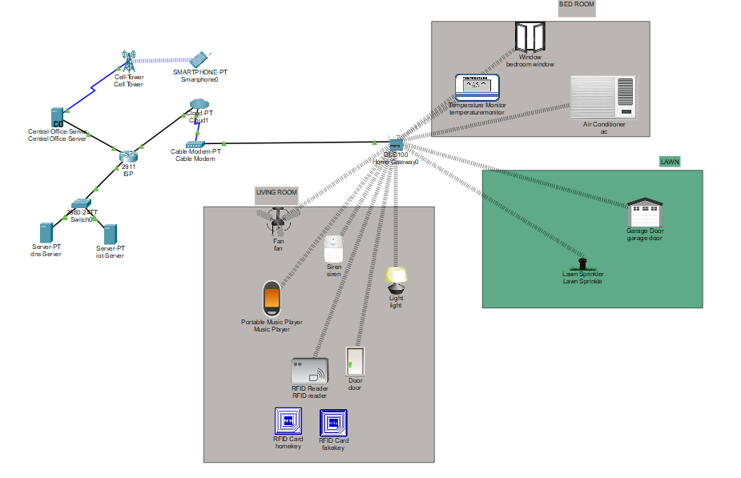

Slide 4
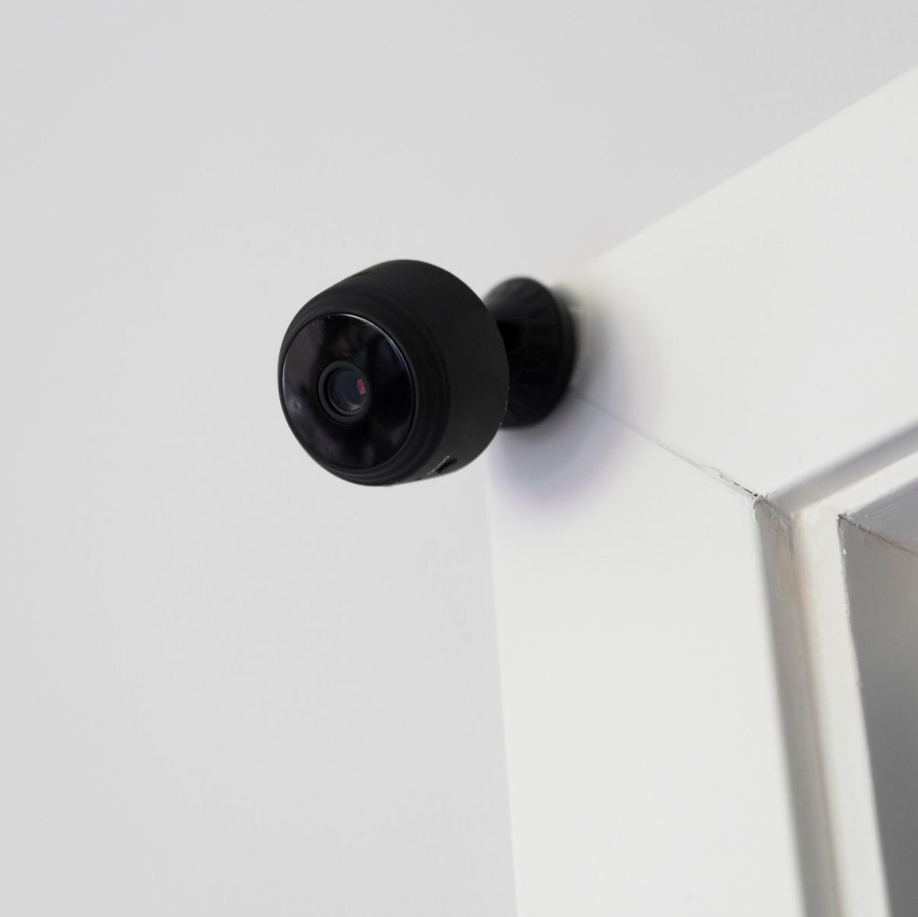
INTRODUCTION
01.
The IoT-Based Smart Home Automation integrates devices like lights, fans, and doors into a centralized network, allowing remote control and automation. Simulated using Cisco Packet Tracer and cloud services, the system enhances comfort, energy efficiency, and security, showcasing the potential of IoT in modern living.

Slide 5
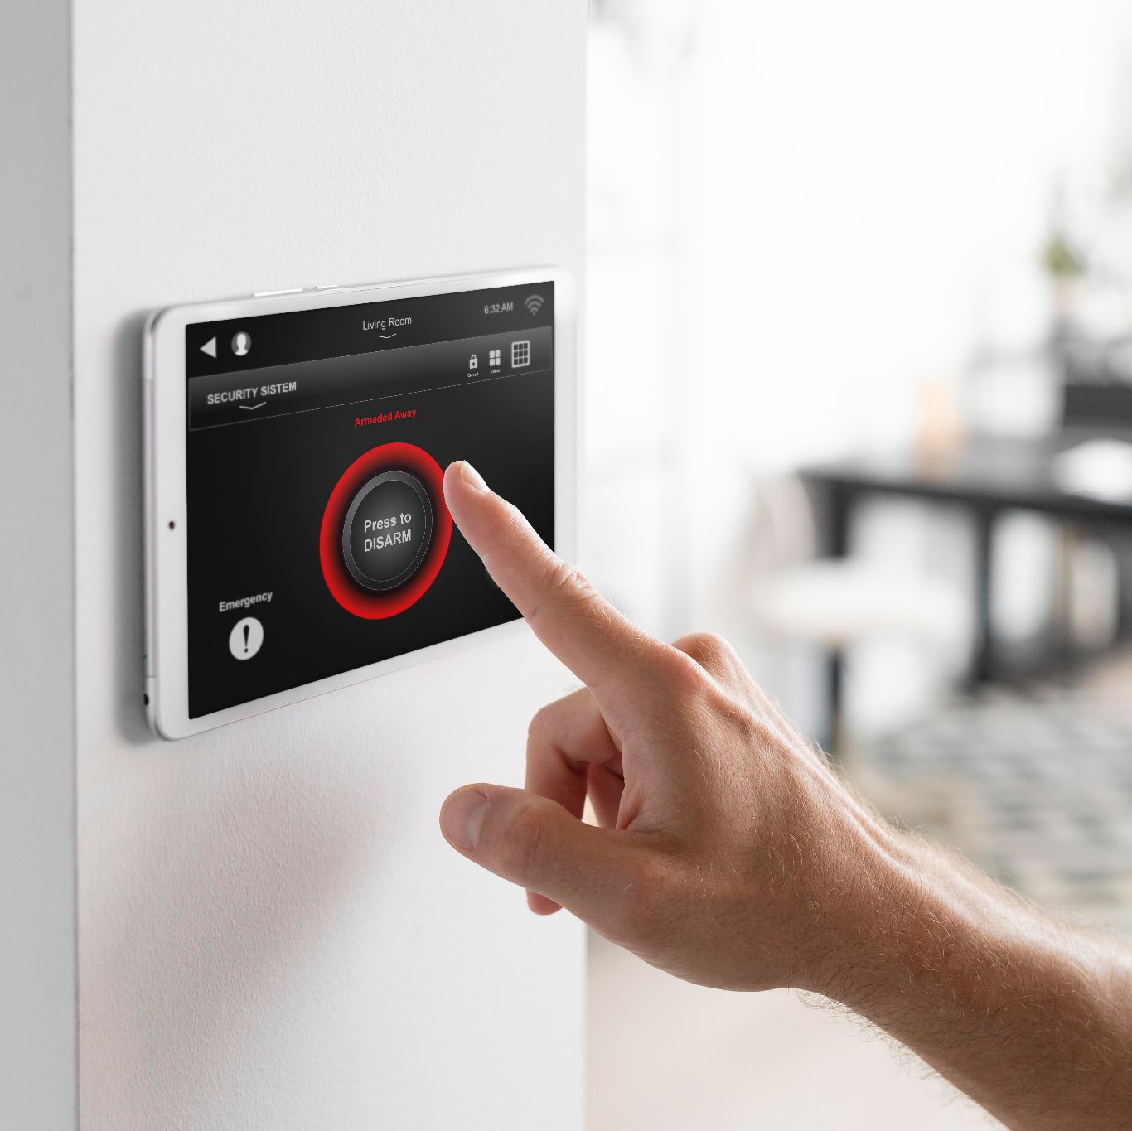
02.
Project Objectives

Slide 6
Project Objectives
Device Automation and Control
Energy Efficiency Monitoring
Enhanced Security Features
Remote control of appliances through a smartphone or web app.
Insights to optimize energy usage and reduce costs.
Real-time alerts and
access control.

Slide 7
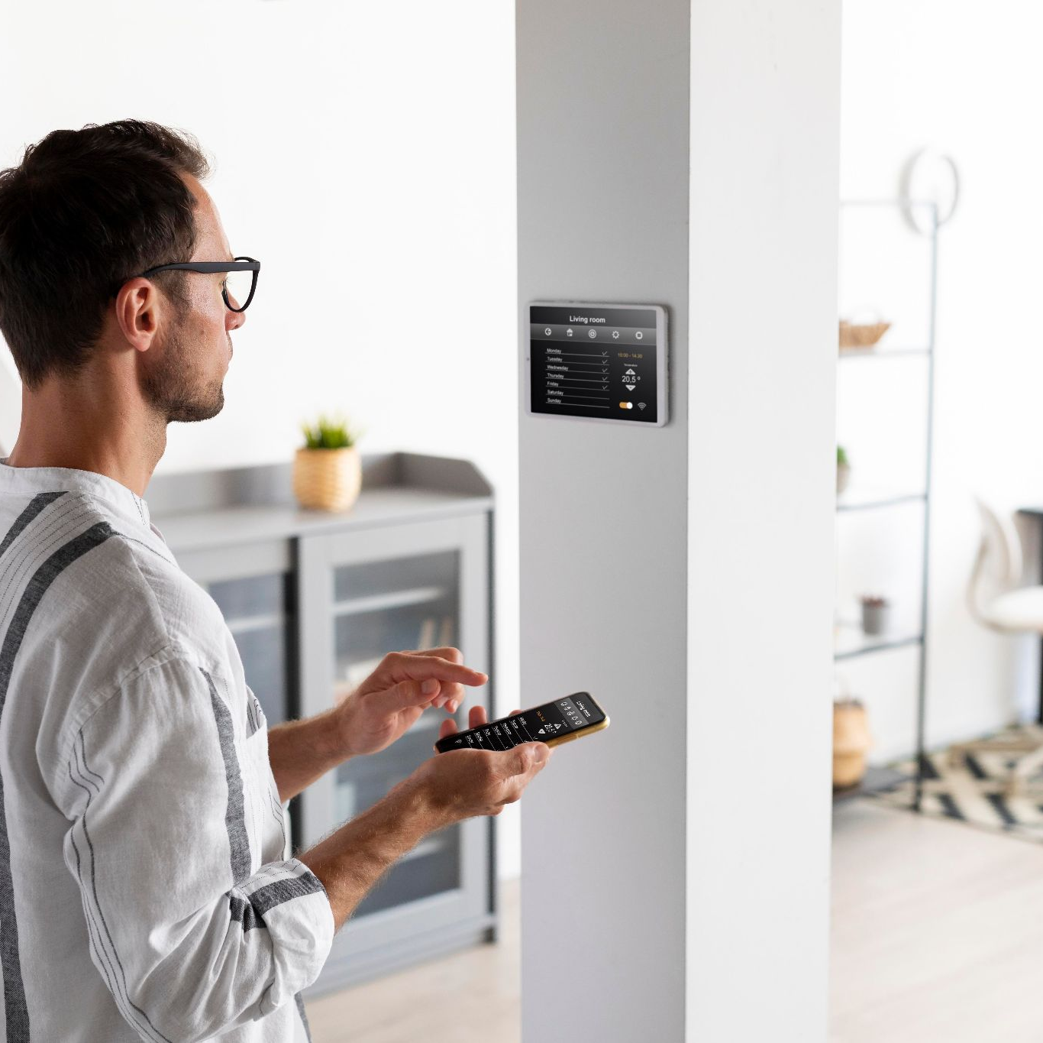
03.
System Components

Slide 8
System Components
Network Devices
Servers
Switch, Router, Modem, Cloud, Home Gateway.
DNS Server, IoT Server, Central Office Server
Client Device
Home Devices
Smartphone app for control and monitoring.
Smart appliances like lights, fans, doors, windows, AC, temperature monitors, etc.

Slide 9
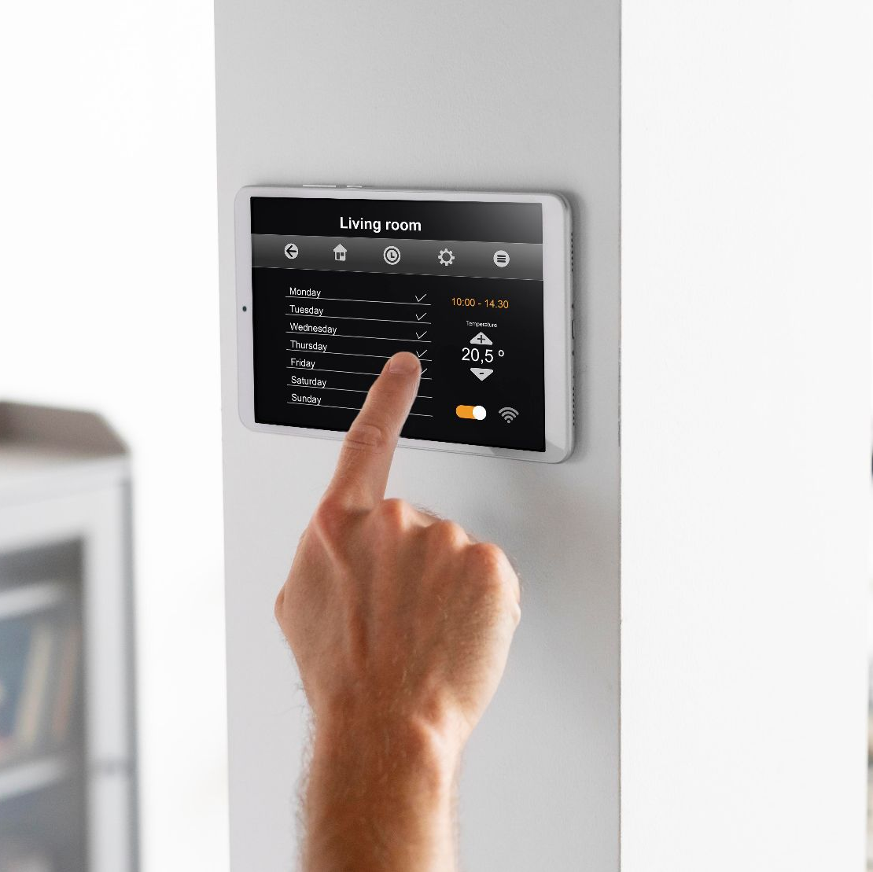
Features and Functionalities
04..

Slide 10
Features and Functionalities
Remote Access | Control devices from anywhere using a smartphone or web app.
Automation | Automated triggers based on temperature and security inputs (e.g., RFID for smart door).
Energy Management | Monitoring energy usage to optimize consumption.
Security Integration: | Secure access via RFID and anomaly alerts.

Slide 11
Benefits
05..

Slide 12
Benifits
Increased comfort with remote access.
Improved home security with real-time alerts and smart locks.
Energy savings through monitoring and automation.

Slide 13
Conclusion
06..
The IoT-Based Smart Home Automation project demonstrates how IoT technology can transform everyday living by integrating home devices into a centralized, remotely accessible system. By enabling automation, energy monitoring, and enhanced security, the project highlights significant improvements in convenience and efficiency. Simulated with Cisco Packet Tracer, it provides a practical model for modern, connected living. Future enhancements could include AI integration and expanded device compatibility, further enhancing the system’s capabilities.

Slide 14
Thank you

